Slide 1
Deep Learning
Follow along: https://repl.it/@enscma2/IntroNN
Notes:
This is an introduction to deep learning and neural networks. There’s quite a bit of information, so we’ve split it into two parts and recommend that you split it into two meetings as well.

Slide 2
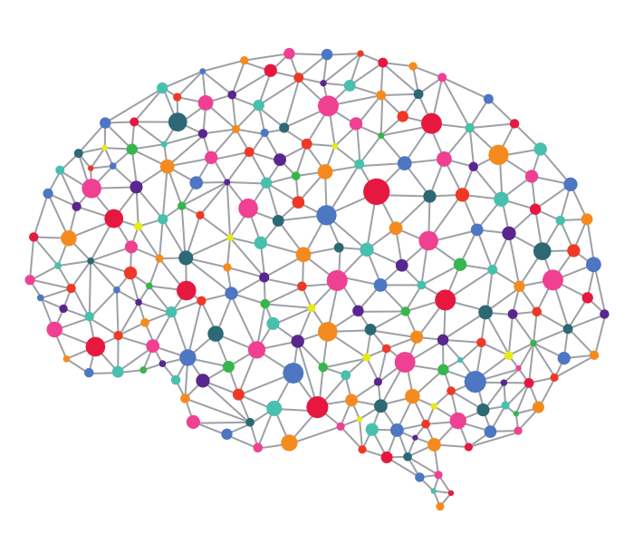
What is deep learning?
Subfield of machine learning
Inspiration: brain
Neural networks
Neural networks
Neural networks
Oh, also, neural networks
Notes:
Deep learning is a subfield of machine learning, and the inspiration for the field is that researchers want computers to emulate brains - the main tool they use to do this is called a neural network

Slide 3
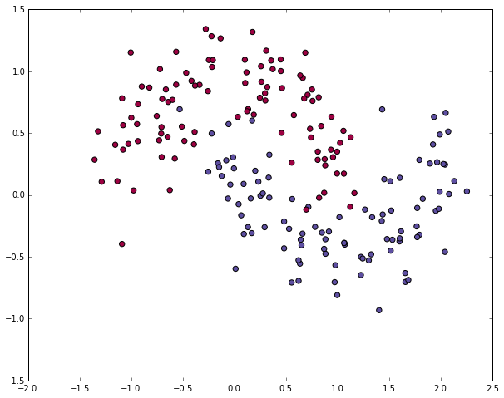
What are neural networks?
Fancy algebra
Recall: support vector machines found a boundary to separate two classes
Neural networks are just fancy functions that represent boundaries
So a neural network is just a fancy support vector machine
Notes:
Neural networks are basically fancy algebra - basic machine learning algorithms find boundaries to separate classes, and neural networks just find fancy boundaries - in the image, an SVM would basically find the linear boundary, whereas a neural network would be able to capture a more nuanced boundary like the curvy one

Slide 4
Ok Maybe There’s a Little More
Learns its own features instead of getting fed features
That’s why it’s like a brain
The brain learns stuff on its own
This is useful because it’s really hard to come up with precise fancy functions
So the network does it for you
Notes:
Ok, maybe they’re not *just* fancy algebra
In regular machine learning, we give a model the features to learn from - whether it’s words & frequencies, lengths & widths, or whatever
In deep learning, we don’t do that - we just tell the computer to look at data and ~learn~ on its own, which is why it’s like a brain

Slide 5
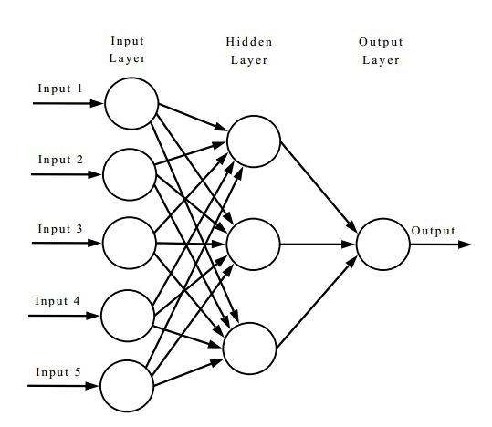
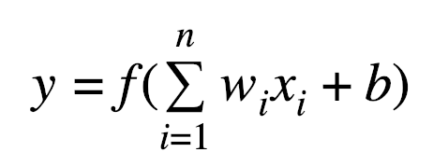
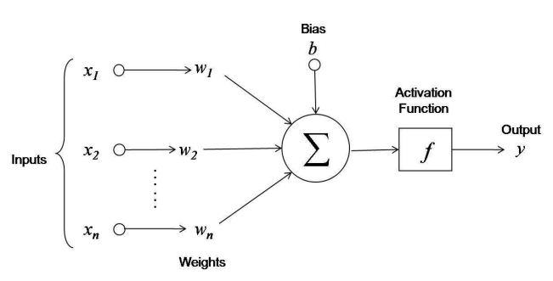
How Neural Networks Work
Input → hidden layer(s) → output
Output of previous layer becomes input of next layer
Linearly combine input features with weights
Pass through an activation function
Notes:
Basic structure of a neural network: you have inputs (data), then a bunch of hidden layers (algebra that we’ll go over in a few slides), then you have your desired output
Inside the hidden layers, the output of one layer becomes the input to the next layer
To generate outputs, we use the formula shown above: we take the input values, multiply each one by some weight w_i, add them all up, and add a constant b, which is a bias unit
How do we know what w and b are? We learn them - usually by starting with random values and then iteratively improving
Once we have that sum, we then pass it through an activation function (more on next slides) to get our output for that layer

Slide 6
What We Choose vs. What It Learns
We choose:
Activation functions
Loss function & learning rate
Number of layers
Number of weights
It learns:
Weights
Bias unit
Features (inputs)
(Maybe) coefficients of activation functions
Notes:
So an overview: a neural network consists of some things we choose, and some things we learn
We choose activation functions to pass our weighted sums through to an output
We choose a loss function (some function to measure how “badly” we’re doing) and learning rate (a constant to tell us how much to shift our weights by given the output of the loss function) - basically we choose how we respond to feedback
We choose the general structure of the network, including number of layers and number of weights
The network learns the actual weights and the bias units
The network learns the features (inputs) at every step inside the network
We could also make the network learn the coefficients of the activation functions - this is up to us though

Slide 7
How It Learns
Optimizes a loss function
Smaller = better
Uses gradient descent
Slowly adjust the weights
Each time, decrease by the learning rate until you get to the smallest loss
Notes:
How does a neural network “learn”? The short answer is that we give it a loss function, and we tell it to minimize that loss function. The loss function is some sort of function that tells us how “badly” we’re doing, and we basically want to move in the direction of decreasing that badness (more explanations later)
How do we minimize the loss function? We use gradient descent (the precise mathematical walkthrough of this concept requires multivariable calculus, so we won’t cover it formally), which is basically slowly adjusting our weights by a value called the learning rate until we get our smallest possible loss

Slide 8
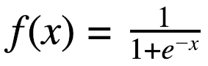
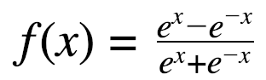
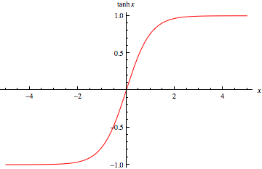
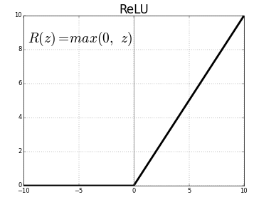
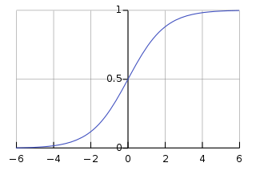
Activation Functions
Goal: have an output 0 < y < 1 or -1 < y < 1
Default for binary classification is negative if 0 < y < .5 and positive if .5 <= y < 1, but this can be changed as you please
Sigmoid:
Tanh:
Rectified Linear Unit
Notes:
Some common choices for activation functions
The motivation is that our goal is to have an output between 0 and 1 (typically) - so for example, if we want a network that classifies something as a cat or not a cat, we can say that if our output < 0.5, it’s not a cat, otherwise it is a cat
Formulas are basically given here

Slide 9
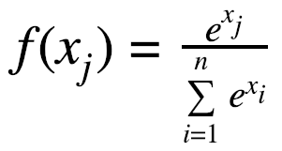
Our Final Activation Function: Softmax
Input: output vector from previous layer
Output: vector probabilities that a data point belongs to each class
Basically, the formula “normalizes” the vector so that the probabilities add up to 1
Formula for each input in the input vector:
Example: input [2, 3, 4]
Denominator = e² + e³ + e⁴
Numerators: e², e³, e⁴
Output: [e²/(e² + e³ + e⁴), e³/(e² + e³ + e⁴), e⁴/(e² + e³ + e⁴)]
They clearly sum to 1
Probability that the data belongs to the first class = e²/(e² + e³ + e⁴), etc
Notes:
The final activation function is a bit different because we need to not just return one number, but a vector of probabilities for each outcome - to do this, we use the softmax function, which is given in the formula in the slide

Slide 10
Piecing the Network Together
b₁
s₁= x₁w₁₁+ x₂w₂₁+ x₃w₃₁+ x₄w₄₁ + x₅w₅₁+ b₁
y₁= tanh(s₁)
x₁
y₁
s₂= x₁w₁₂+ x₂w₂₂+ x₃w₃₂+ x₄w₄₂ + x₅w₅₂+ b₂
y₂= tanh(s₂)
x₂
b₂
x₃
y₂
z
s₃= x₁w₁₃+ x₂w₂₃+ x₃w₃₃+ x₄w₄₃ + x₅w₅₃+ b₃
y₃= tanh(s₃)
x₄
y₃
z = softmax([y₁, y₂, y₃])
x₅
b₃
Notes:
Here’s an example of a network and how we might calculate our output - basically just step through it

Slide 11

Application: Diabetes Classification
Data: https://tinyurl.com/pima-indians-diabetes-data
Download by right clicking anywhere on the page and clicking “Save As”
Save as “pima-indians-diabetes.data.csv”
Open https://repl.it/languages/python3
Q: given these features, does the person have diabetes?
Notes:
A small example application: diabetes classification! We’re given some features about a group of Native Americans, and we want to know whether, given those features, a particular person has diabetes
Follow the instructions to download the data, open up a new repl.it coding environment

Slide 12
Implementation!
import numpy as np
from keras.models import Sequential
from keras.layers import Dense
import tensorflow as tf
dataset = np.loadtxt("pima-indians-diabetes.data.csv", delimiter=",")
# split into input (X) and output (Y) variables
X = dataset[:,0:8]
Y = dataset[:,8]
model = Sequential()
model.add(Dense(3, input_dim=8, activation='tanh'))
model.add(Dense(1, activation='softmax'))
Notes:
Step through this code
Import all of the necessary packages (keras is a state-of-the-art package for deep learning, and it is built on top of tensorflow, which is a state-of-the-art package for machine learning)
Load the text using numpy, which conveniently has a function that loads a csv for us
Then, we need our input and output variables - in this dataset, the last column is the output, and this notation is basically a way to get every entry in the nth column
To build a neural network in keras, we start it off with a Sequential() - this basically means that we don’t have anything in parallel, we’re just stacking layers on top of each other in order
Add two layers for now, both pretty straightforward layers, choose activations & number of layers, input dimension specifies the number of input features to expect

Slide 13
Recap & A Look Ahead
Code from to day: up through line 14 on https://repl.it/@enscma2/IntroNN
Next week:
Deep dive into how it learns
A look at loss functions
Compile, train, evaluate, and translate the model

Slide 14
Deep Learning: Part #2

Slide 15
Today
Recap of basic neural networks
Deep dive:
Loss functions
Gradient descent
Compile, train, evaluate

Slide 16
Recall (1/3)
Notes:
Recapping what we learned before - basically just summarize the explanation of the neural network from the previous part in the best way you see fit

Slide 17
Recall (2/3)
b₁
s₁= x₁w₁₁+ x₂w₂₁+ x₃w₃₁+ x₄w₄₁ + x₅w₅₁+ b₁
y₁= tanh(s₁)
x₁
y₁
s₂= x₁w₁₂+ x₂w₂₂+ x₃w₃₂+ x₄w₄₂ + x₅w₅₂+ b₂
y₂= tanh(s₂)
x₂
b₂
x₃
y₂
z
s₃= x₁w₁₃+ x₂w₂₃+ x₃w₃₃+ x₄w₄₃ + x₅w₅₃+ b₃
y₃= tanh(s₃)
x₄
y₃
z = softmax([y₁, y₂, y₃])
x₅
b₃
Notes:
Keep summarizing

Slide 18
Recall (3/3)
Data: https://tinyurl.com/pima-indians-diabetes-data
Download by right clicking anywhere on the page and clicking “Save As”
Save as “pima-indians-diabetes.data.csv”
Q: given these features, does the person have diabetes?
import numpy as np
from keras.models import Sequential
from keras.layers import Dense
import tensorflow as tf
dataset = np.loadtxt("pima-indians-diabetes.data.csv", delimiter=",")
# split into input (X) and output (Y) variables
X = dataset[:,0:8]
Y = dataset[:,8]
model = Sequential()
model.add(Dense(3, input_dim=8, activation='tanh'))
model.add(Dense(1, activation='softmax'))
Notes:
Summarize the coding & the example task

Slide 19
How it Learns: Gradient Descent & Loss
Loss function: how “wrong” are we?
We obviously want to be less wrong
Gradient descent: slowly becoming less wrong
How slowly?
Based on this, we update the weights and refine our model
Notes:
Loss function = measure of how “wrong” we are, and we want to be as not wrong as possible
Reiterate what gradient descent is

Slide 20
Loss Functions
A measure of how wrong we are
Abstractly: L = y - ŷ
Many different types of functions
Each one is different
Hence, the model performs differently, depending on which one we choose
Commonly chosen functions:
Mean squared error, mean absolute error
Hinge, squared hinge
Cross entropy
Notes:
Abstractly, a loss function is y - y-hat, which is how much the actual outputs, y, differ from the predicted outputs, y-hat
There are lots of different loss functions, which we’ll go through in the next few slides

Slide 21
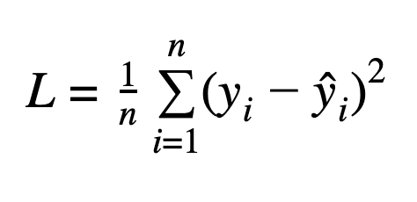
Mean Squared Error Loss
def mean_squared_error(actual, predicted): sum_square_error = 0.0 for i in range(len(actual)): sum_square_error += (actual[i] - predicted[i])**2.0 mean_square_error = 1.0 / len(actual) * sum_square_error return mean_square_error
Note: y is a number between 0 and 1, representing a probability Variant: mean absolute error loss--add up absolute values of losses instead of squares
Notes:
Basically take the difference between each prediction and the actual output, square it, sum the squares, and divide by the number of samples (hence why it’s called mean squared error)
A variant of this is to just do absolute values instead of squares - point is to keep all of them positive
Step through the code as well

Slide 22
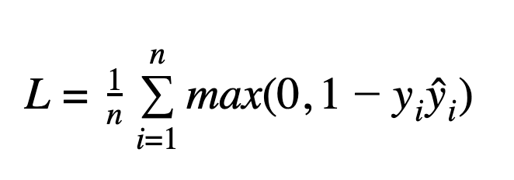
Hinge Loss
def hinge(actual, predicted):
sum_score = 0.0
for i in range(len(actual)):
sum_score += max(0, 1 - actual[i] * predicted[i])
mean_sum_score = 1.0 / len(actual) * sum_score
return mean_sum_score
Note: a variant of this is squared hinge loss, where you add up the squares of the maxes instead of just the maxes
Notes:
Another type of loss is hinge loss, which is the max of 0 and 1 - the product of the actual output and the predicted output, then averaged
You can also square the maxes

Slide 23
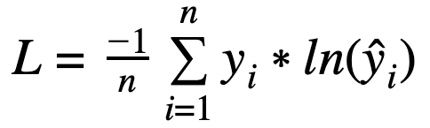
Cross Entropy Loss
from math import log
def binary_cross_entropy(actual, predicted):
sum_score = 0.0
for i in range(len(actual)):
sum_score += actual[i] * log(1e-15 + predicted[i])
mean_sum_score = 1.0 / len(actual) * sum_score
return -1 * mean_sum_score
Note: in practice, we add a small value to the argument of the log to avoid having log(0)
Perfect score in theory is 0
Perfect score in practice is very small, but not 0
Notes:
Cross entropy loss: take the product of the actual output and the natural log of the prediction, sum, and divide by -1/n

Slide 24
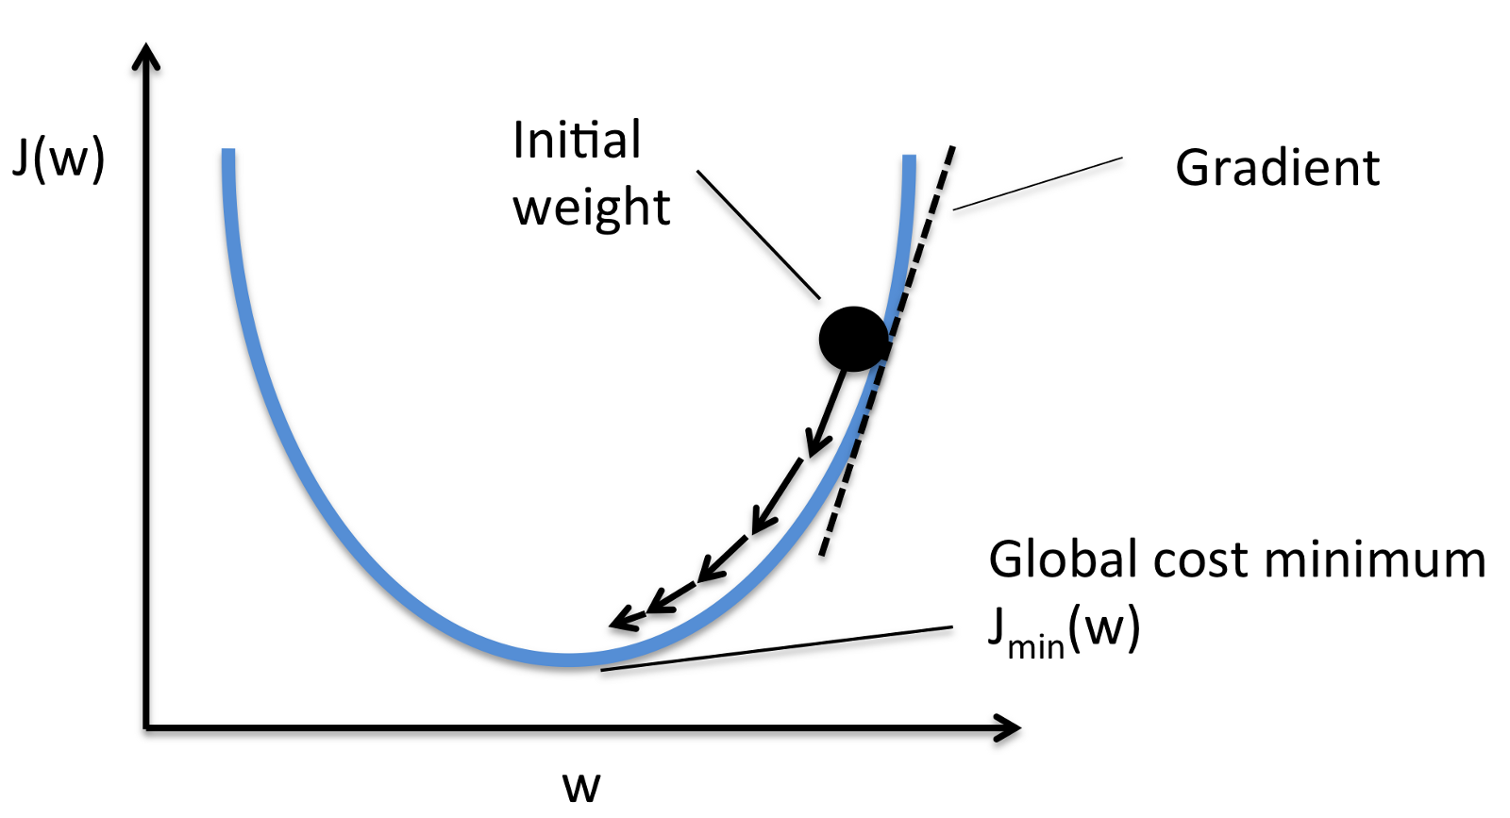
What do we do with the loss?
Learn!
Update parameters
Use gradient descent
Notes:
A visualization of gradient descent - we basically get there slowly

Slide 25
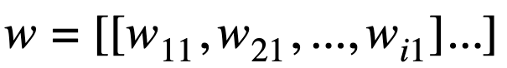
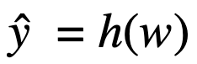
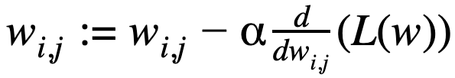
Gradient Descent
α = learning rate
Partial derivative: how much the loss function slopes in the direction of w_{i,j}
Slowly descend at the pace of the learning rate
Do this until convergence: until weights don’t change much anymore
Large α = goes fast but might skip over minimum of loss or might diverge
Small α = won’t do that but also takes hella time
Notes:
Mathematical formulas for gradient descent: w is the vector of weights on the network
The prediction is a function of the weights (including the bias unit)
At each step of gradient descent, update each weight by subtracting the learning rate (alpha) times the partial derivative with respect to that weight of the loss function value
There are tradeoffs to large & small learning rates
Keep updating until the weights don’t really change much (you can decide when to stop)

Slide 26
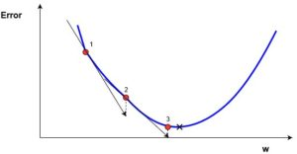
A Variant: Stochastic Gradient Descent
Only uses the part of the data you train on, so it goes much faster
In contrast, normal gradient descent iterates through all the data
So if you aren’t immortal, you should probably use SGD if you want to get stuff done in life
Notes:
Variant of gradient descent: SGD
Basically you train data in batches, and so while gradient descent looks at all of the data, SGD only looks at a particular batch, so it’s a lot faster

Slide 27
Pulling it Together: Pipeline
Get data, turn it into numbers, etc, feed it in
Make a network, pick some things
Learning rate
Number of layers & nodes in each layer
Activation functions
Loss function
Start the network with random weights and bias units
Take some data and train and validate it through the network
Pick how much data you want to use at a time
Calculate the loss
Update the weights with [stochastic] gradient descent
Do 4 - 6 many times until loss converges (gets minimized)
Pick how many times you want to do it
Notes:
Pulling it together, this is the deep learning pipeline

Slide 28
Finally: Evaluate the Model
Various metrics to measure performance
One of the most common is accuracy
Just # correct/ # test data points
Notes:
The last step is to see how the model did, by evaluating it! There are various ways to measure performance, but the most common is accuracy

Slide 29
Code!
# Compile the model
model.compile(loss='binary_crossentropy', optimizer='sgd', metrics=['accuracy'])
print(model.summary())
# Fit the model
model.fit(X, Y, epochs=10, batch_size=10)
# evaluate the model
scores = model.evaluate(X, Y)
print("\n%s: %.2f%%" % (model.metrics_names[1], scores[1]*100))
Notes:
Here’s the code! We’re going to compile the model with binary cross entropy loss, use stochastic gradient descent, and return the accuracy performance metric
Then we will fit the model (basically tell the model to learn from) X, the input data we had earlier, and Y, the input labels we had earlier
We’re going to run it for 10 epochs (loosely this means training 10 times), and with a batch size of 10, so we look at 10 pieces of data at a time
Then, we evaluate the model on our input data/labels, and we print it out

Slide 30
Recap & Other Stuff
Code from today: https://repl.it/@enscma2/IntroNN
Next week(s): fancier networks
Recurrent neural networks
Convolutional neural networks
LSTM networks
All of those mixed together sprinkled with even more fun stuff

